Slide 1

مبادرة ألف مهندس ذكاء اصطناعي التعلم العميق
Course Project
Name of project :
Binary Image Classification
Multi Image Classification
Group members:
Mona Ahmed Yosn
Mohamed Ouriha
Mohamed Eslam Abdel-Rahman
Abdullh Hsn Agah
Osamah Khaled Abdulhadi
Supervised by
Dr. Hesham Asem

Slide 2
Contents
1- Introduction
2- Binary Classification Data
3- CNN ARCHITECTURE
4- Results and Discussion

Slide 3
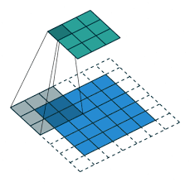
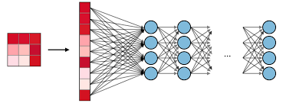
Introduction
The Convolutional Neural Network (CNN or ConvNet) is a subtype of the Neural Networks that is mainly used for applications in image and speech recognition. Its built-in convolutional layer reduces the high dimensionality of images without losing its information. That is why CNNs are especially suited for this use case.

Slide 4

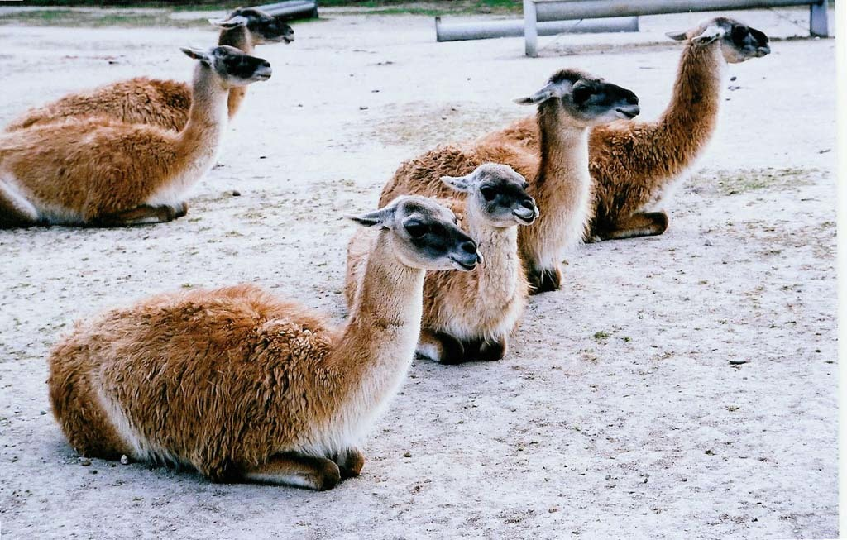

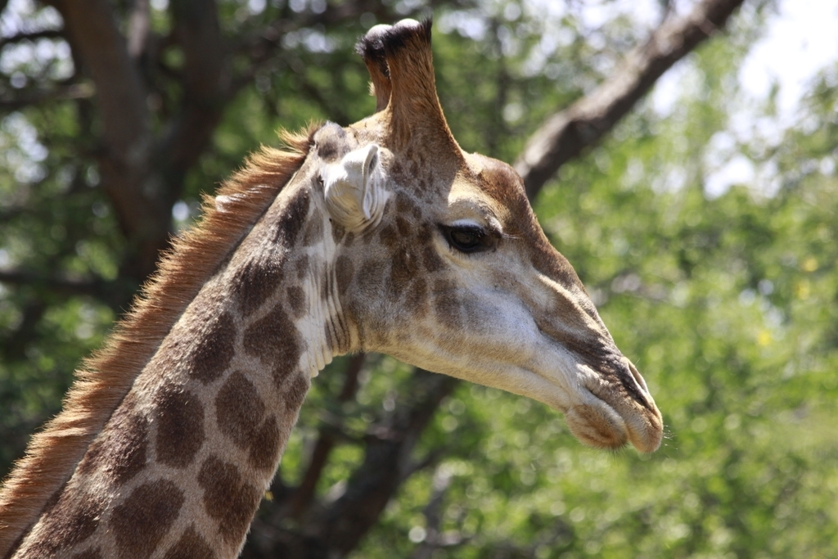
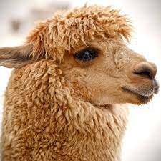
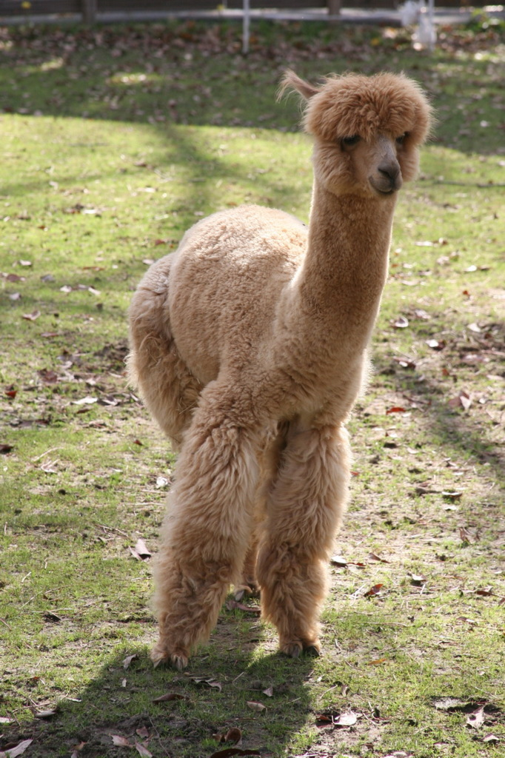
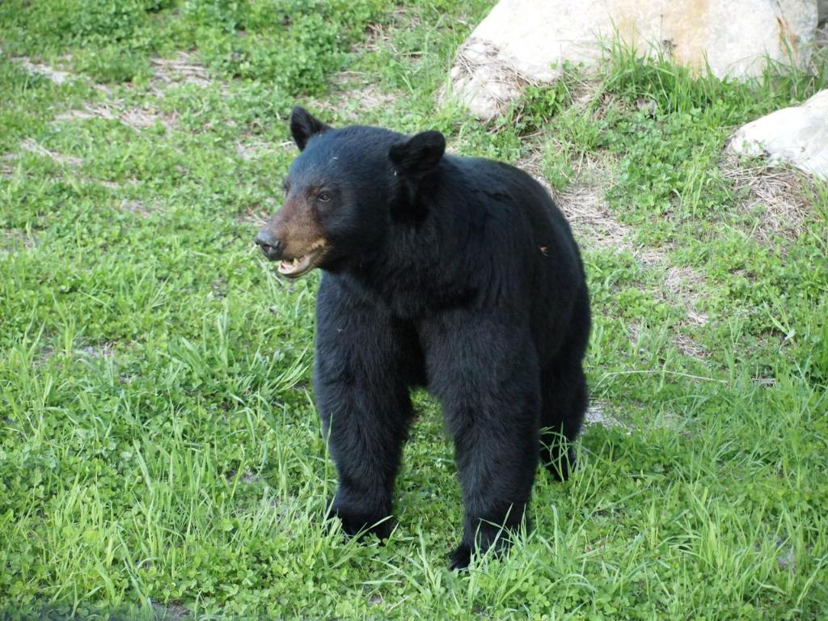

Data of Binary Classification Project:
Alpaca(142 IMG)
Not Alpaca(185 IMG)

Slide 5
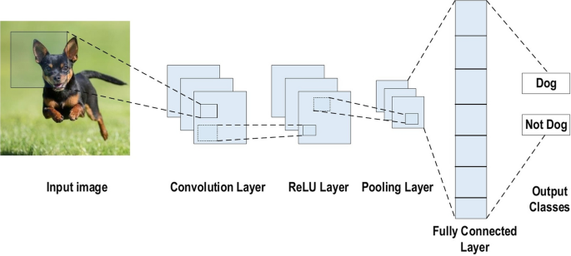


CNN ARCHITECTURE
CNN has three types of layers to build architectures apart from input layer:
Convolutional Layer (with ReLU activation).
Pooling Layer.
Fully Connected or Dense Layers.

Slide 6
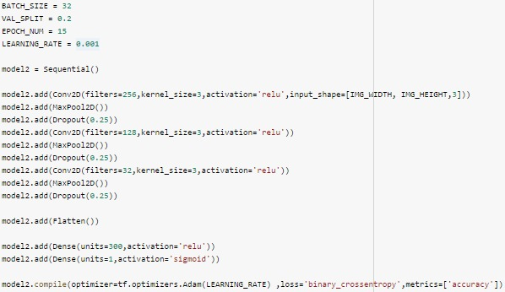
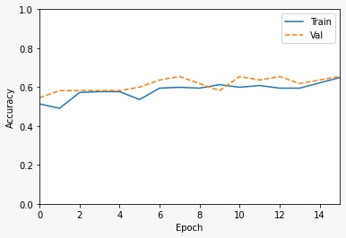
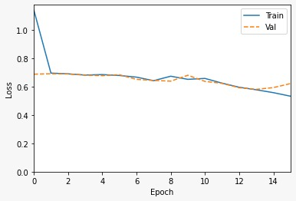
Results(A)

Slide 7
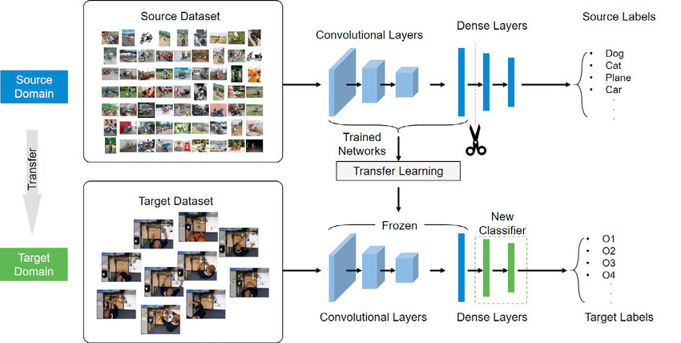
Pretrained model

Slide 8
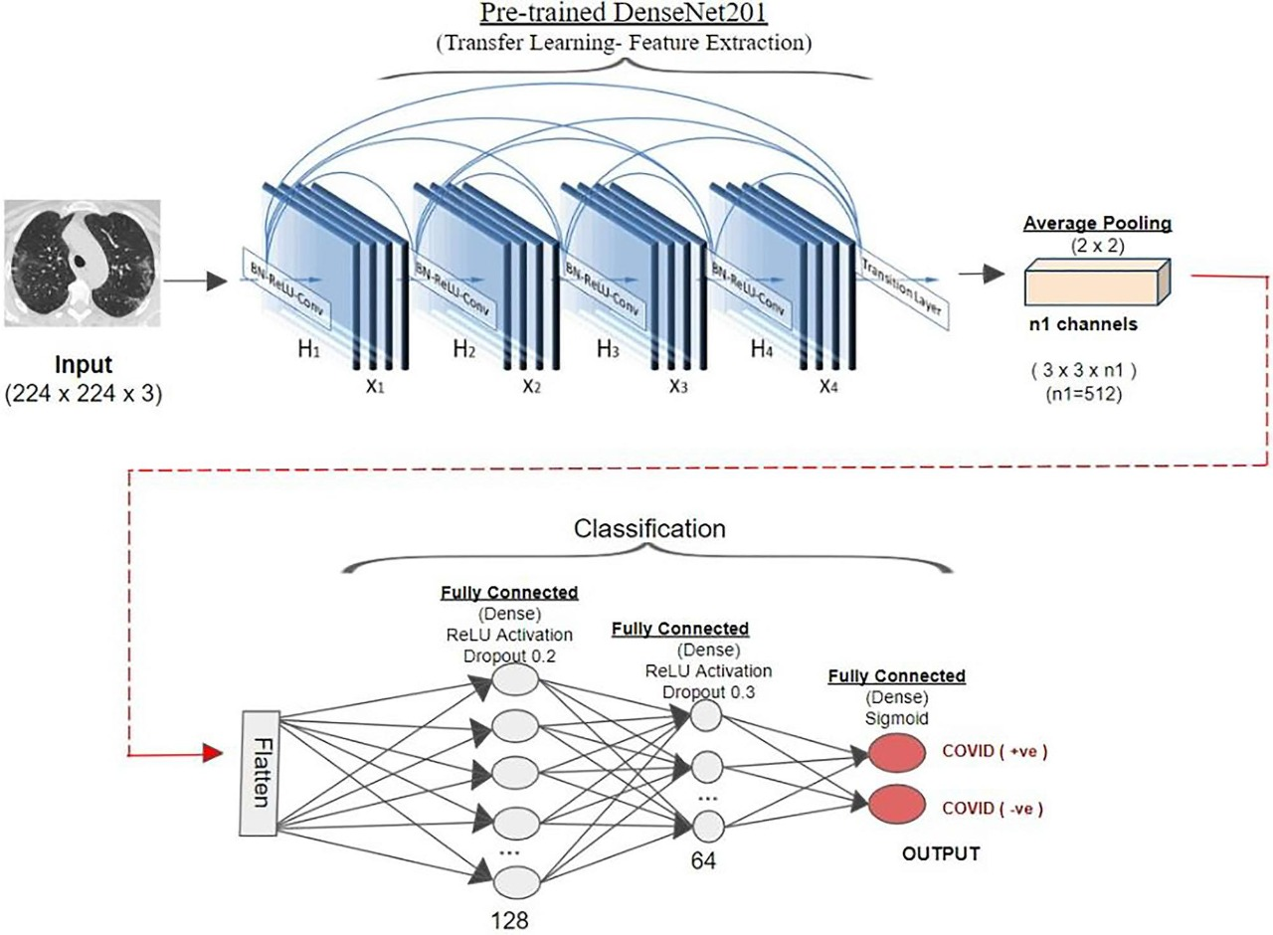
CNN Model (Densenet)
Code link :
https://www.kaggle.com/code/monagaffer12345/aplaca-project

Slide 9
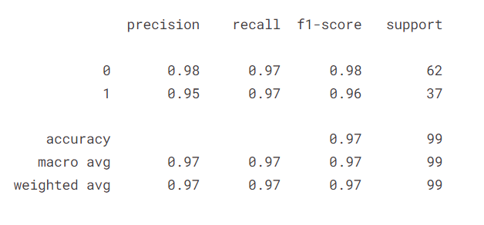
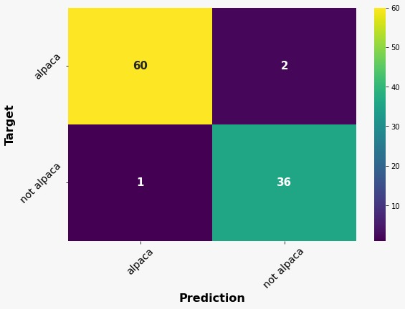
Results (B)

Slide 10
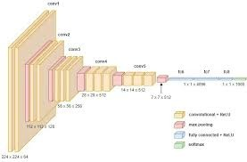
CNN_VGG16

Slide 11
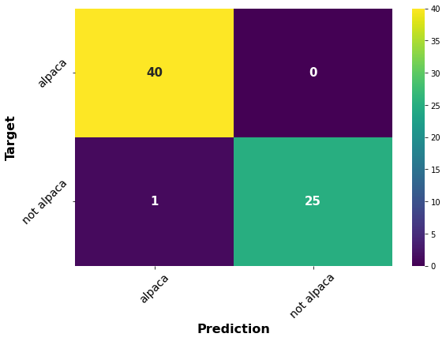
Results_VGG
precision recall f1-score support
0 0.98 1.00 0.99 40
1 1.00 0.96 0.98 26
accuracy 0.98 66
macro avg 0.99 0.98 0.98 66
weighted avg 0.99 0.98 0.98 66

Slide 12


